Slide 1
Controller-Plant model for DC motor
June 2024
<Chayuth Thanakitkoses>
Intern engineering - KPIT Technologies

Slide 2
Overview
Basic Controller-Plant model
PID controller
Implementation of the plant model
Torque control DC motor
Speed control DC motor

Slide 3
1. Basic Controller-Plant model
(Real System)
Desired value
+
Error
PID
Controller
Plant
System Output
Controlled
input
-
(controller input)
(controller output)
Actual value

Slide 4
1. Basic Controller-Plant model
Plant Model
(Real System)
Desired value
+
Error
PID
Controller
Plant
System Output
Controlled
input
-
(controller input)
(controller output)
Actual value

Slide 5
1. Basic Controller-Plant model
Controller Model
(Real System)
Desired value
+
Error
PID
Controller
Plant
System Output
Controlled
input
-
(controller input)
(controller output)
Actual value

Slide 6
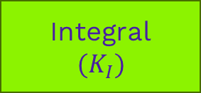
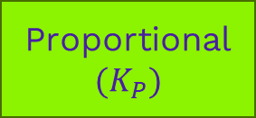
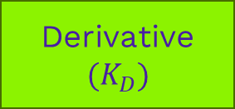
2. PID Controller
Proportional
$${(K}_{P})$$
(Real System)
Desired value
+
Error
Plant
System Output
Integral
$${(K}_{I})$$
Controlled
input
-
Derivative
$${(K}_{D})$$
PID controller
Actual value

Slide 7
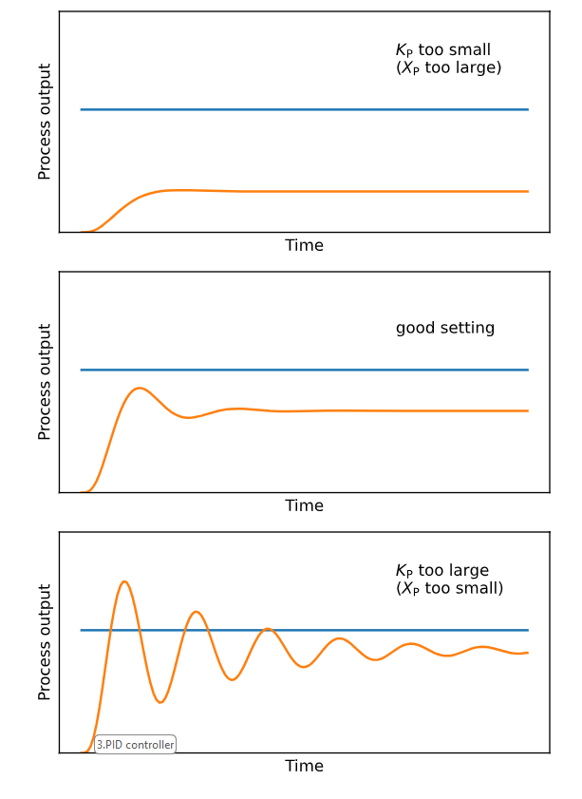
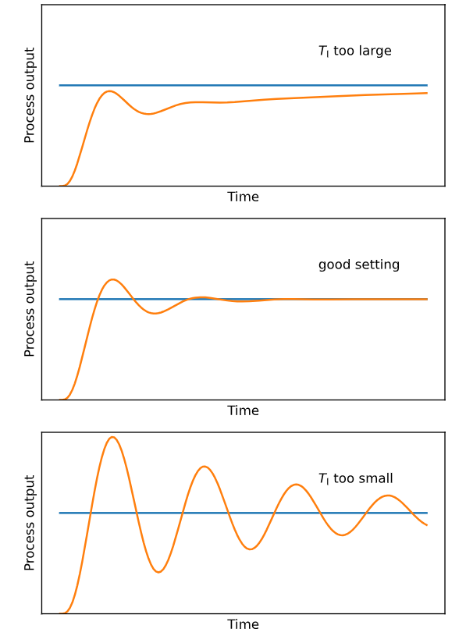
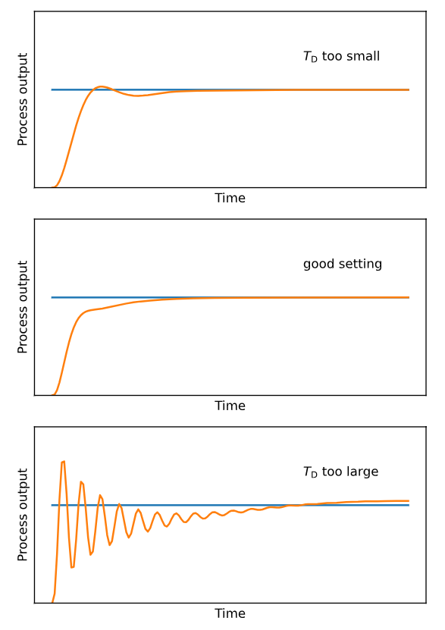

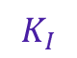
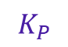
PID Tuning
$$K_{P}$$
$$K_{I}$$
$$K_{D}$$
Proportional
Integral
Derivative

Slide 8
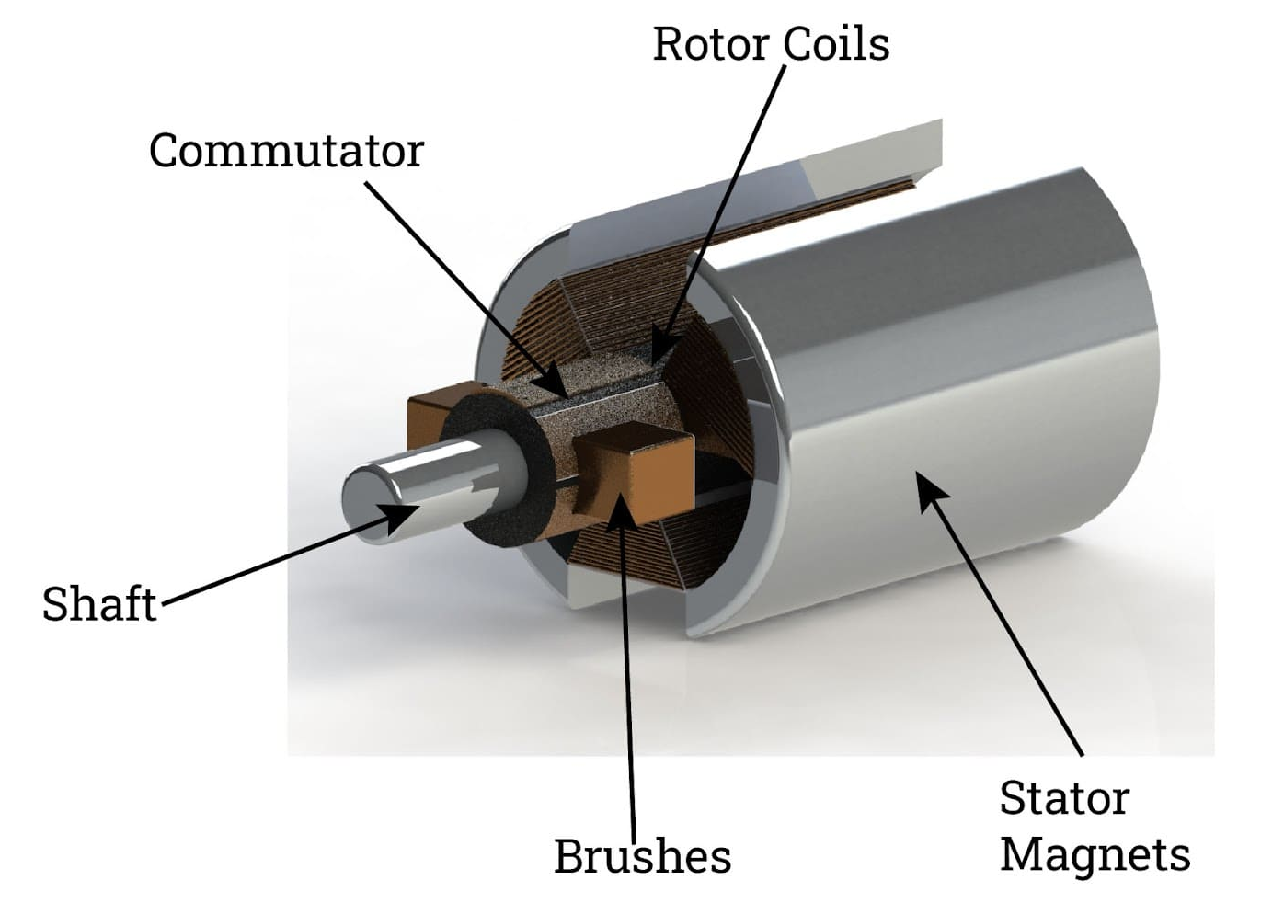
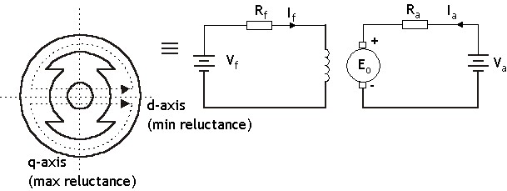
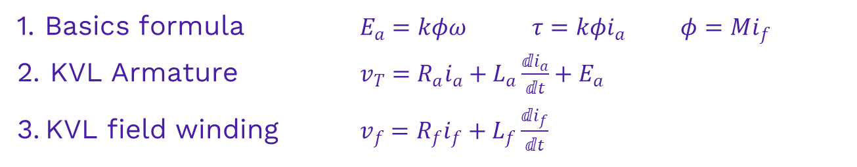
3. Implementation of Plant model
Field winding
(represents stator)
Armature
(represents rotor)
Stator
Rotor
1. Basics formula $E_{a}=kφω τ=kφi_{a} φ=Mi_{f}$ 2. KVL Armature $v_{T}=R_{a}i_{a}+L_{a}\frac{ⅆi_{a}}{ⅆt}+E_{a}$
3. KVL field winding $v_{f}=R_{f}i_{f}+L_{f}\frac{ⅆi_{f}}{ⅆt}$

Slide 9
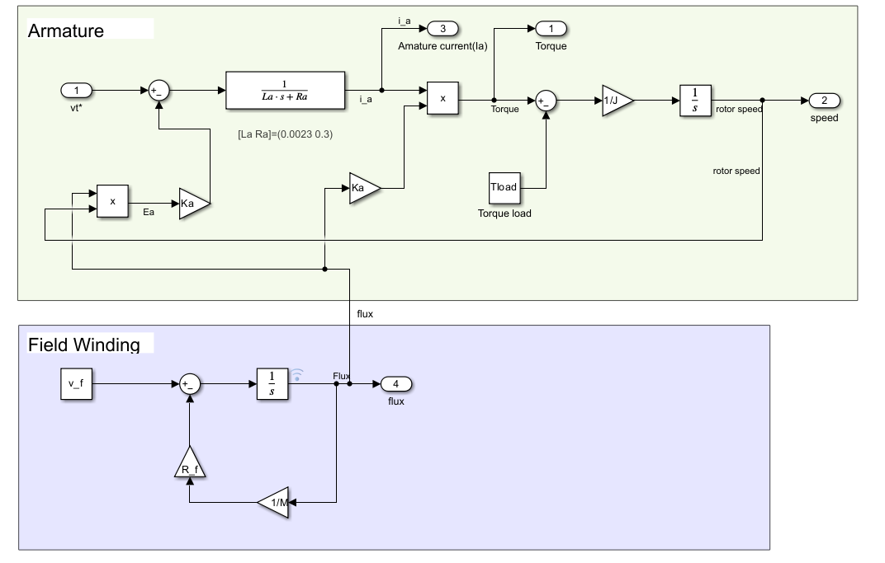





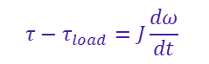

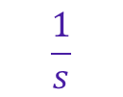
3. Implementation of Plant model
Input
$$τ=kφi_{a}$$
Output
$$\frac{1}{s}$$
$$τ$$
$$θ$$
$$V_{T}$$
$$ω$$
$$τ−τ_{load}=J\frac{dω}{dt}$$
$v_{T}=R_{a}i_{a}+L_{a}\frac{ⅆi_{a}}{ⅆt}+E_{a}$
$$E_{a}=kφω$$
$$v_{f}=R_{f}i_{f}+L_{f}\frac{ⅆi_{f}}{ⅆt}$$
$$φ=Mi_{f}$$

Slide 10
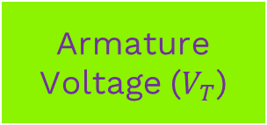

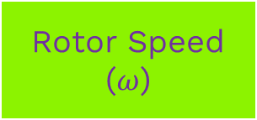

3. Controlled signals
Output
Torque ($τ$)
Input
Armature Voltage ($V_{T}$)
Rotor Speed ($ω$)
Position ($θ$)

Slide 11
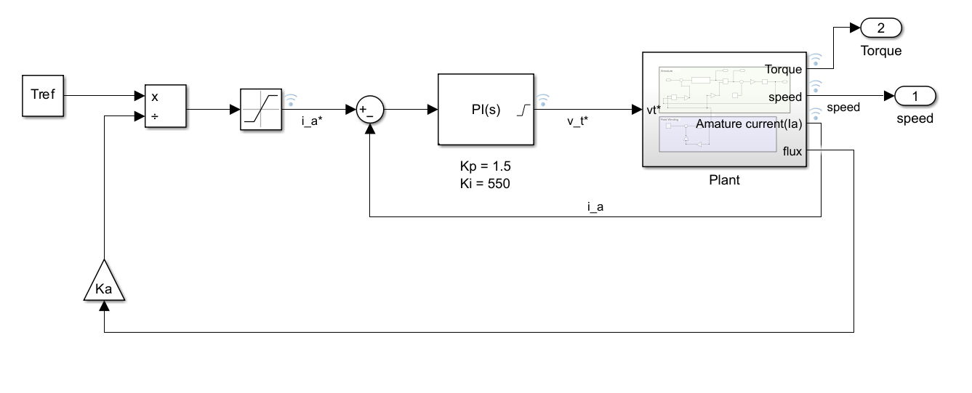


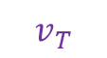

4. Torque control DC motor
(Use $V_{T}$ to control $τ$)
Aim for the steady-state : $τ_{load}=$ $τ_{ref}$
$$τ=kφi_{a}$$
$$v_{T}$$
Controls

Slide 12
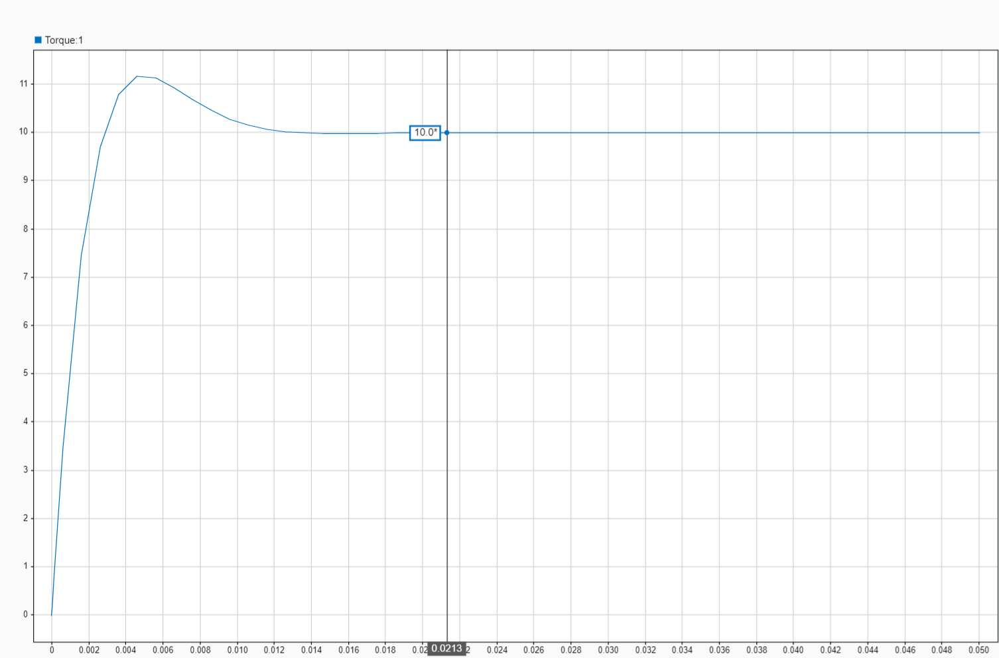



4. Torque control DC motor
$τ_{load}=$ $τ_{ref}=10 N∗m$
$τ_{load}=$ $τ_{ref}=20 N∗m$

Slide 13
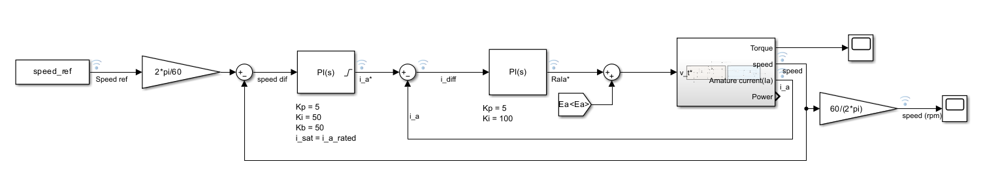




5. Speed control DC motor
(Use $V_{T}$ to control $ω$)
$ω$*
$i_{a}$*
$V_{T}$*

Slide 14
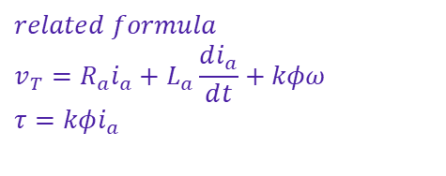

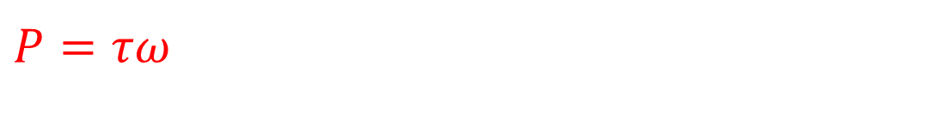


5. Speed control DC motor
(Use $V_{T}$ to control $ω$)
$$τ$$
$P=τω$
$$τ_{rated}$$
$$φ_{rated}$$
$$related formula$$
$$v_{T}=R_{a}i_{a}+L_{a}\frac{ⅆi_{a}}{ⅆt}+kφω$$
$$τ=kφi_{a}$$
0
$$ω$$

Slide 15




5. Speed control DC motor
$$P_{max}=τω_{base}$$
Every motors has their maximum
power that they can drive.
Limitation :
$$τ$$
$$constant torque state$$
$P=τω$
$$τ_{rated}$$
Limitation
$$φ_{rated}$$
$ω_{ref}$ < $ω_{base}$
$$ω$$
0
$$ω_{base}$$

Slide 16
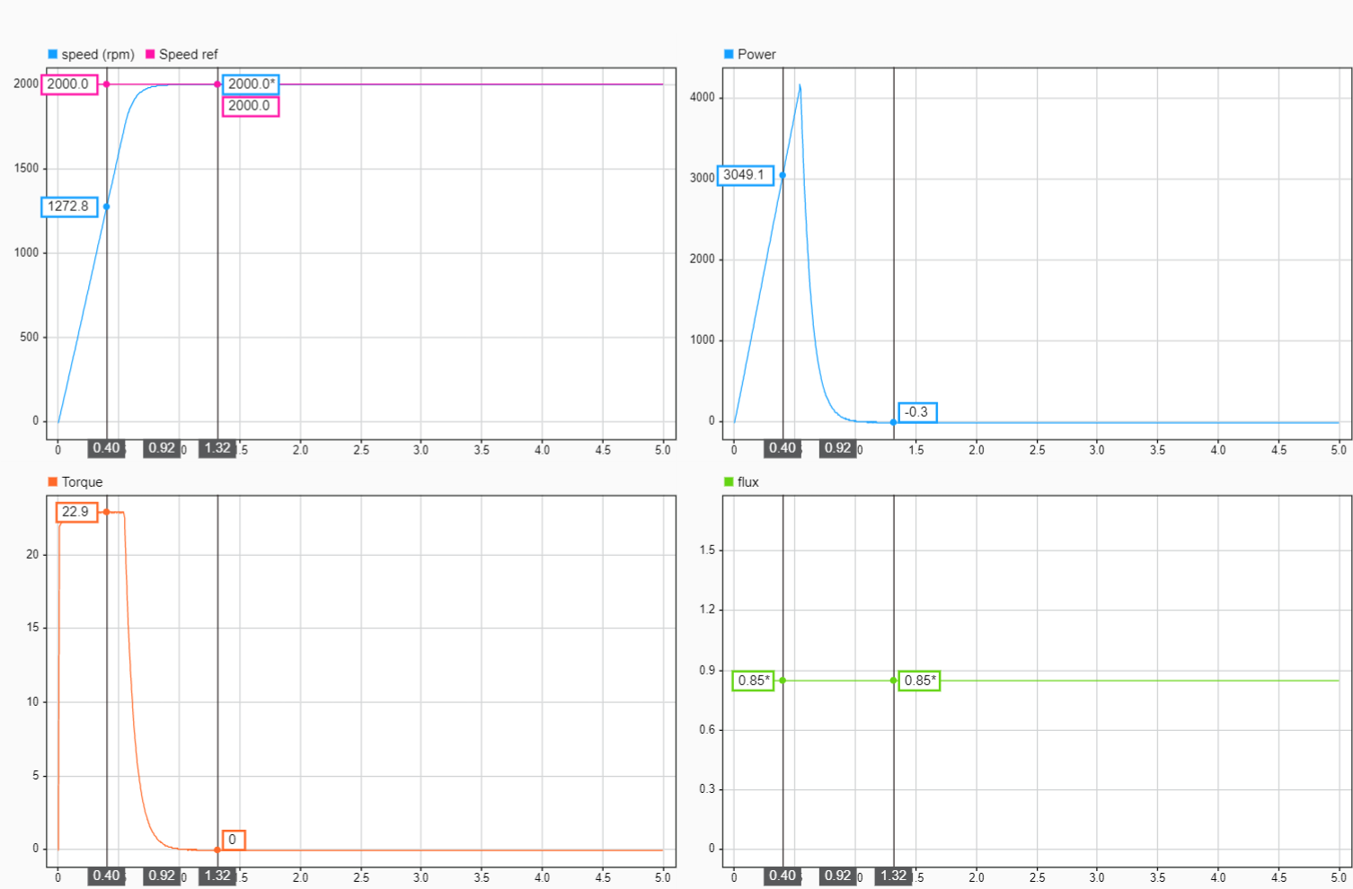









5. Speed control DC motor
$ω_{ref}$ = 2000 rpm = 209.4 rad/s
$ω_{ref}$ < $ω_{base}$
1. Constant Torque state
2. Steady-state
$ω_{base}$ = 2500 rpm = 261.7994 rad/s
$$P_{max}≈6 kW$$
$$1$$
$$2$$
$$1$$
$$2$$
$$1$$
$$2$$
$$τ_{load}=0 N∗m$$

Slide 17

What if we want $ω_{ref}$ > $ω_{base}$ ?

Slide 18
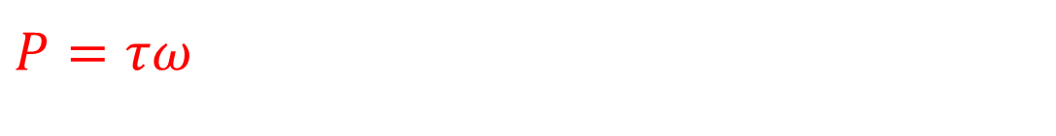

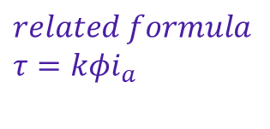

Field Weakening
$$P_{max}=τω_{base}$$
Limitation :
$$field weakening state$$
$$τ$$
$P=τω$
$$τ_{rated}$$
$$φ_{rated}$$
$$related formula$$
$$τ=kφi_{a}$$
0
$$ω$$
$ω_{ref}$ > $ω_{base}$
$$ω_{base}$$

Slide 19
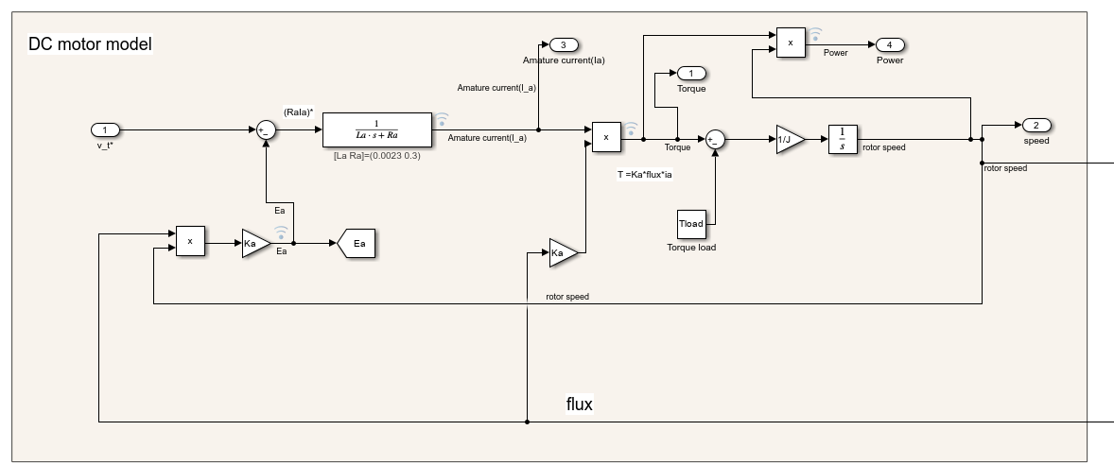
5. Speed control DC motor

Slide 20
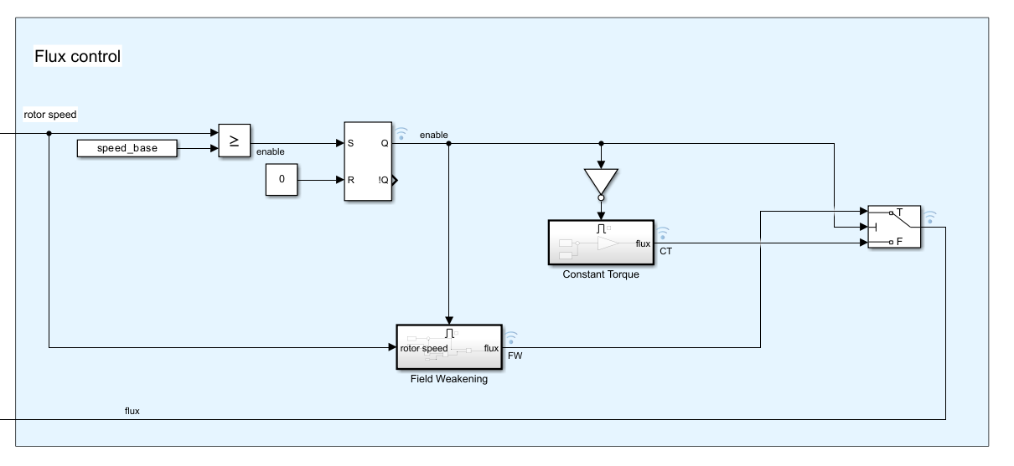
5. Speed control DC motor

Slide 21
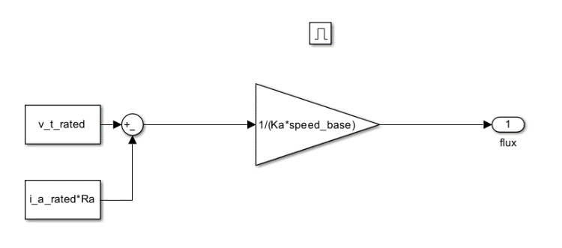
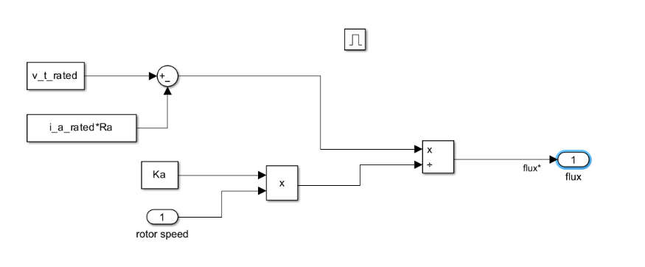


5. Speed control DC motor
Constant Torque state
Field Weakening state
$$φ_{rated}= \frac{V_{T,rated}−R_{a}i_{a}}{Kω_{base}}$$
$$φ= \frac{V_{T,rated}−R_{a}i_{a}}{Kω} ;ω≠0$$

Slide 22
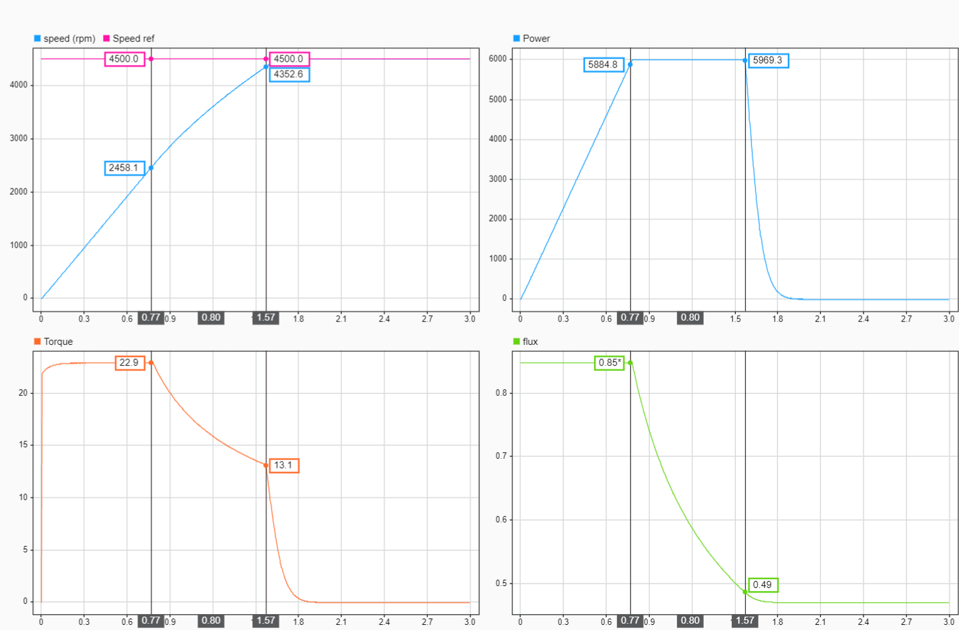













5. Speed control DC motor
$ω_{ref}$ = 4500 rpm = 471.2389 rad/s
$ω_{ref}$ > $ω_{base}$
1. Constant Torque state
2. Field Weakening state
3. Steady-state
$ω_{base}$ = 2500 rpm = 261.7994 rad/s
$$P_{max}≈6 kW$$
$$1$$
$$2$$
$$3$$
$$1$$
$$2$$
$$3$$
$$τ_{load}=0 N∗m$$
$$1$$
$$2$$
$$3$$
$$1$$
$$2$$
$$3$$

Slide 23

Thank You

